Slide 1

Forecasting Model
Real estate
Group 2
Cindy and Iris
04/03/2024
Notes:
Doing research and find the best matrix
Increase the new steps on the existing notebook- PCA, model interpretation-use one of model interpretation (feature importance)- check coefficient- check general one (line gives row by row), check overfitting and underfitting

Slide 2
Why Pick Linear Regression
to use in Real estate?
Simple and interpretable
Fast and efficient
Transparency-identify factors
Can be used in short and long term forecasting
Be used as a baseline model
Notes:
Simple and interpretable: Linear regression is a straightforward model that is easy to understand and interpret, which is advantageous for stakeholders who may not have a deep understanding of complex statistical models.
Assumption of linearity: In real estate, there is often a linear relationship between certain variables, such as square footage, number of bedrooms, location, and property price. Linear regression can capture these relationships effectively.
Transparency: Linear regression allows analysts to easily identify the factors that contribute to changes in property prices. This transparency is valuable for decision-making and understanding market trends.
Efficiency: Linear regression is computationally efficient and can handle large datasets quickly, which is important in real estate where there may be a large number of properties and variables to consider.
Baseline model: Linear regression can serve as a baseline model against which more complex models can be compared. If a linear regression model performs well, there may be little need for more complex approaches.

Slide 3
Application of Linear Regression
Real estate pricing
Sales forecasting
Marketing effectiveness
Risk assessment
Demand forecasting
Performance evaluation
Supply chain optimization
Notes:
Real estate pricing: Predicting property prices based on factors like location, size, number of bedrooms, etc.
Sales forecasting: Estimating future sales based on historical sales data and other relevant variables.
Marketing effectiveness: Assessing the impact of marketing campaigns on sales or customer engagement metrics.
Risk assessment: Predicting the likelihood of loan defaults or insurance claims based on demographic and financial variables.
Demand forecasting: Forecasting demand for products or services based on factors like price, advertising expenditure, and economic indicators.
Performance evaluation: Analyzing the relationship between input variables (e.g., employee training hours) and output metrics (e.g., sales performance) to evaluate performance.
Supply chain optimization: Predicting demand for products to optimize inventory levels and distribution channels.
Customer behavior analysis: Understanding how customer behavior (e.g., website visits, purchase history) is influenced by various factors.
Financial modeling: Predicting stock prices or financial performance based on historical data and market factors.
Healthcare analytics: Predicting patient outcomes or disease risk based on demographic, clinical, and genetic variables.

Slide 4
Popular Algorithms in Real Estate Industry
Time series model
Linear regression model
LSTMs (Long Short-Term Memory networks)
Prophet by Facebook
ARIMA (Autoregressive Integrated Moving Average)
Gradient boost machines (GBM)
Simultaneous Equation Models (SEM)
Random forest
Notes:
Gradient Boosting Machines (GBM): GBM algorithms like XGBoost, LightGBM, and CatBoost are widely used for tasks such as predicting property prices, identifying market trends, and optimizing property listings.
Random Forest: Random Forest models are used for tasks such as property valuation, classification of property types, and predicting property market trends.
Neural Networks: Deep learning models, including various types of neural networks such as convolutional neural networks (CNNs) and recurrent neural networks (RNNs), are used for tasks such as image recognition in real estate (e.g., identifying property features from images), natural language processing (e.g., sentiment analysis of property descriptions), and forecasting property prices.
Support Vector Machines (SVM): SVM models are used for tasks such as classification of properties (e.g., residential vs. commercial) and predicting property prices.
Clustering Algorithms: Clustering algorithms like K-means clustering are used for tasks such as segmenting real estate markets based on property characteristics, customer demographics, or market trends.
Time Series Models: Time series models such as ARIMA (AutoRegressive Integrated Moving Average) and SARIMA (Seasonal ARIMA) are used for forecasting property prices and market trends over time.
Ensemble Methods: Ensemble methods such as bagging and stacking are used to combine the predictions of multiple models to improve accuracy and robustness in tasks such as property valuation and market trend analysis.
Recommender Systems: Recommender systems use algorithms such as collaborative filtering and content-based filtering to provide personalized property recommendations to users based on their preferences, past behavior, and property features.

Slide 5
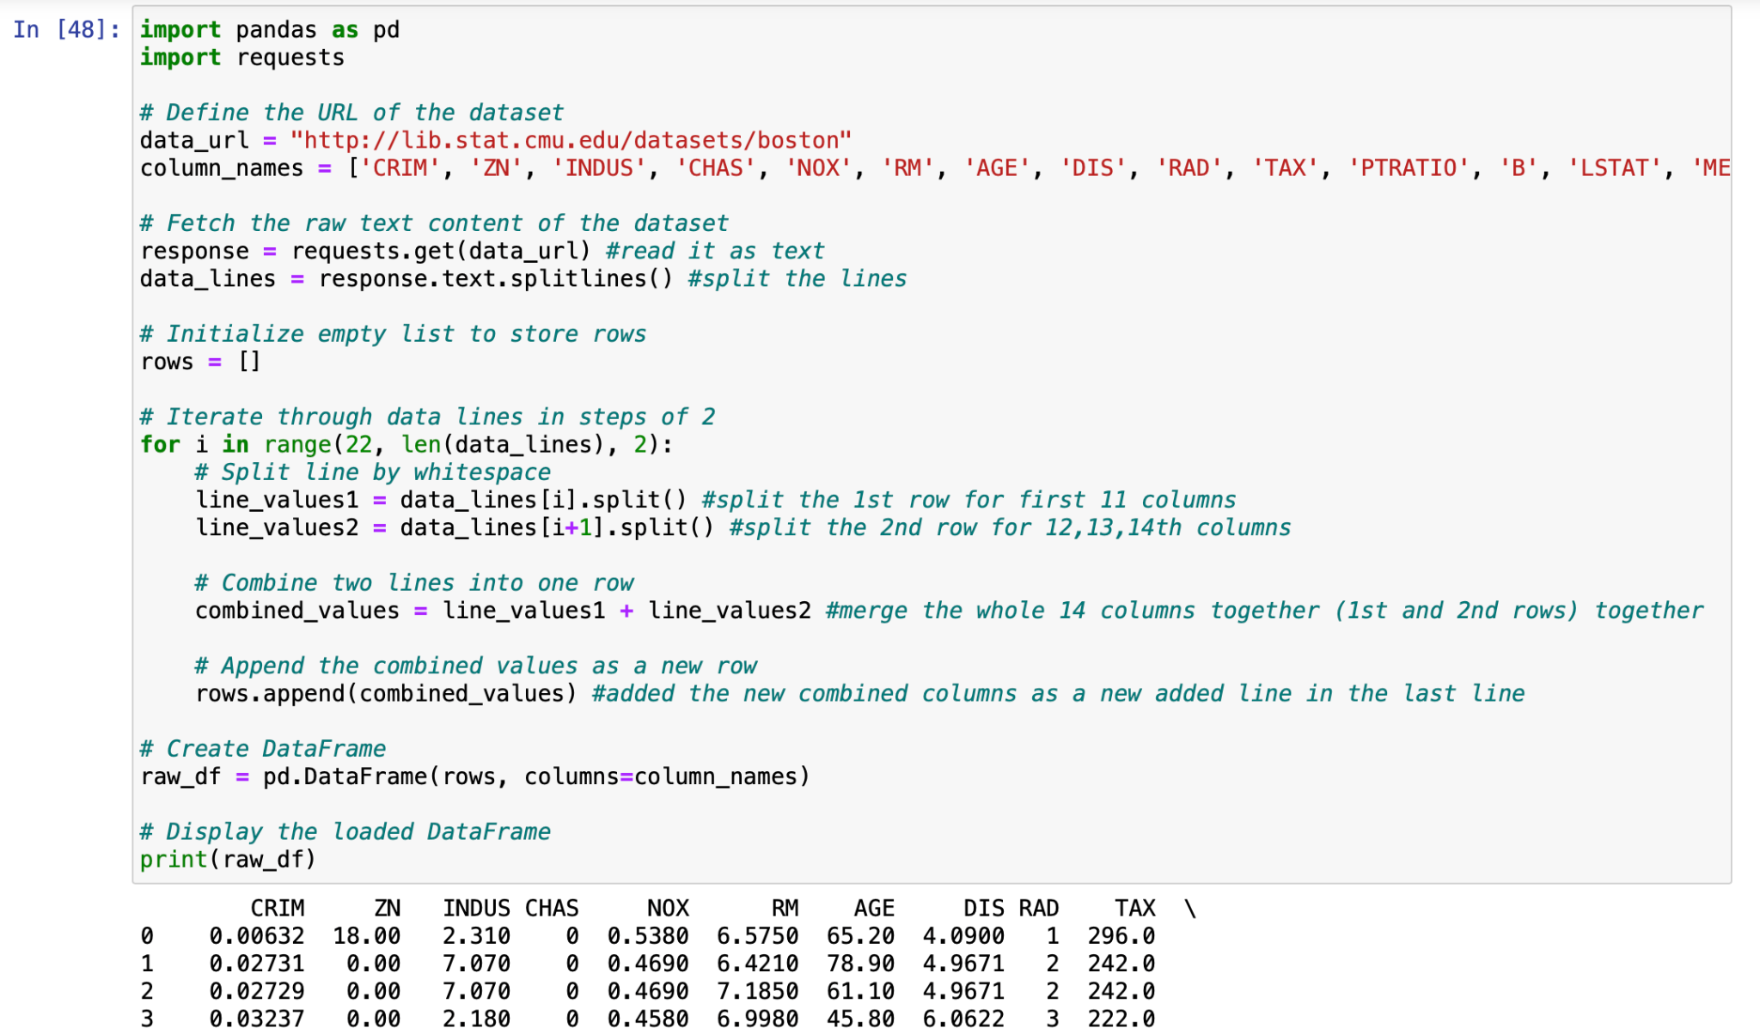
Data Preprocessing
Boston Dataset
Observations: 506 housing districts in the Boston area
Features:CRIM: Per capita crime rate by town
ZN: Proportion of residential land zoned for lots over 25,000 sq.ft.
INDUS: Proportion of non-retail business acres per town
CHAS: Charles River dummy variable (1 if tract bounds river; 0 otherwise)
RM: Average number of rooms per dwelling
AGE: Proportion of owner-occupied units built prior to 1940
DIS: Weighted distances to five Boston employment centres
RAD: Index of accessibility to radial highways
TAX: Full-value property-tax rate per $10,000
PTRATIO: Pupil-teacher ratio by town
B: 1000(Bk - 0.63)^2 where Bk is the proportion of blacks by town
LSTAT: % lower status of the population
MEDV: Median value of owner-occupied homes in $1000's (Target Variable

Slide 6
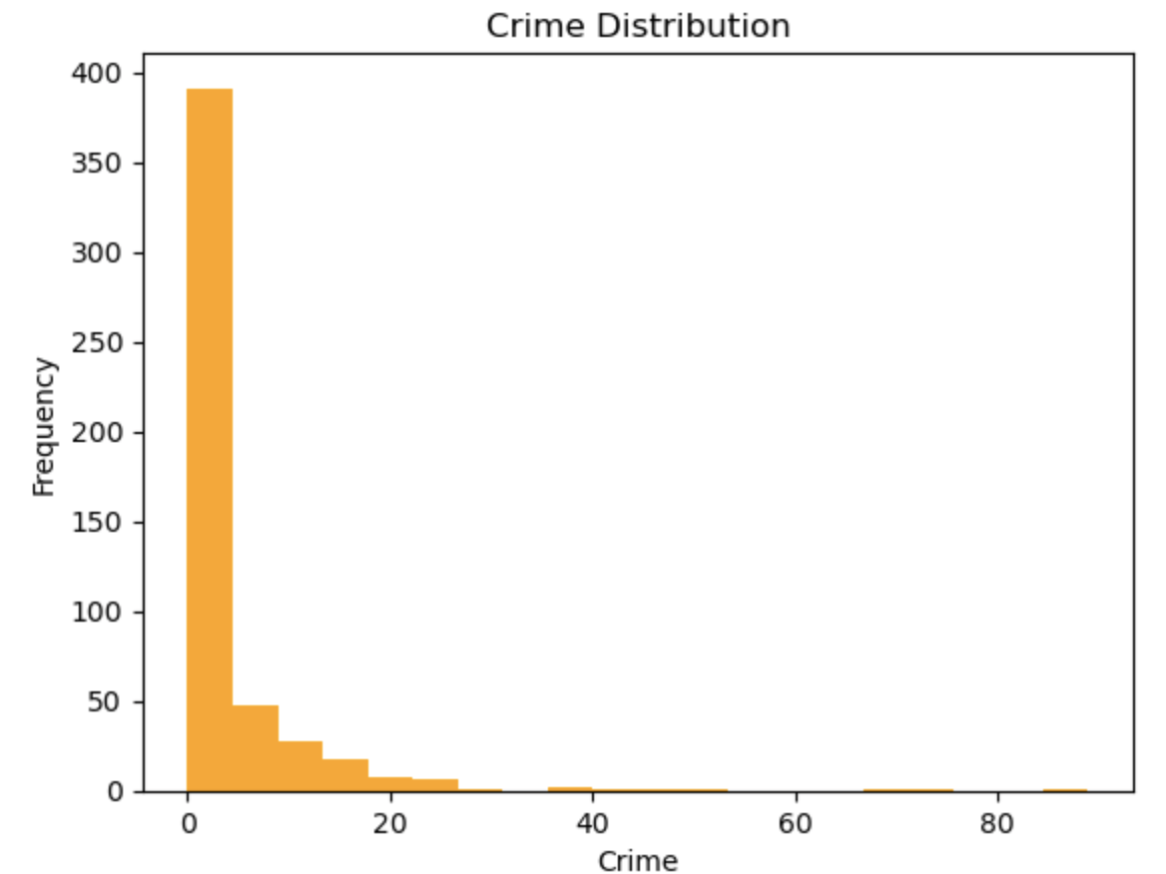
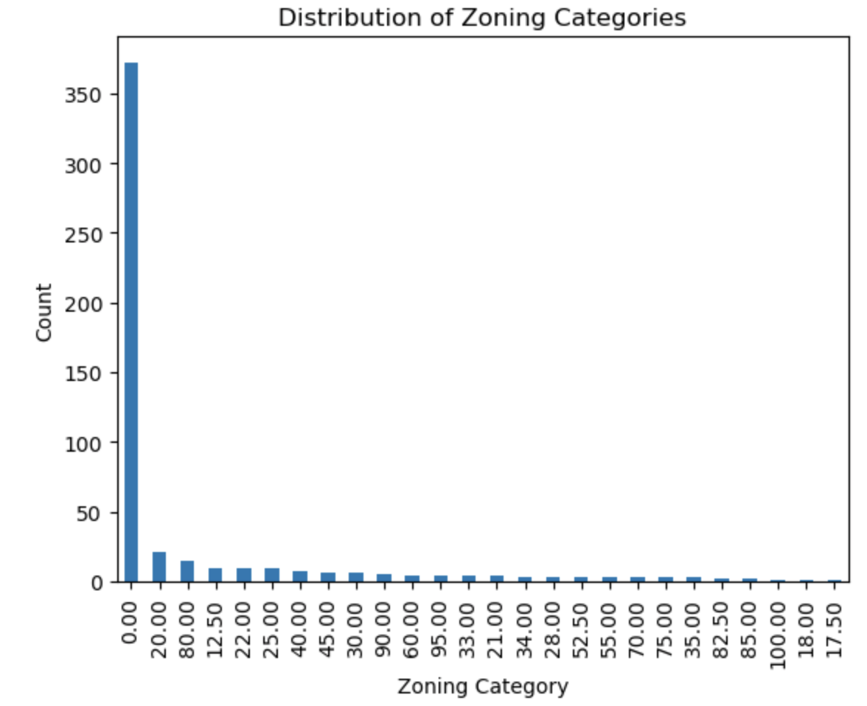

Slide 7
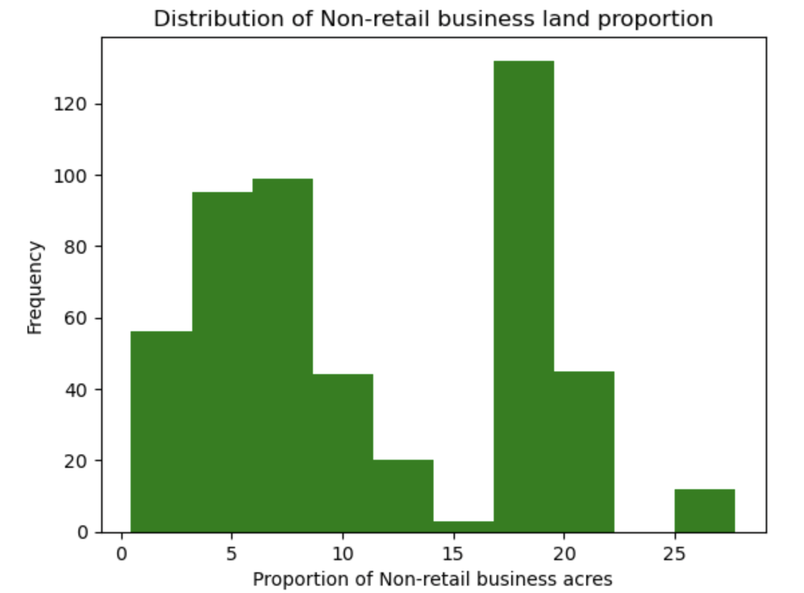
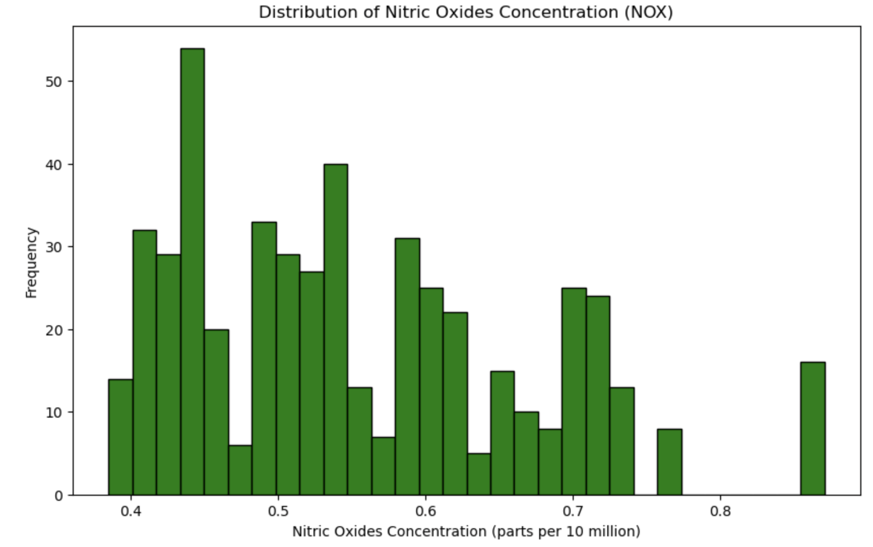

Slide 8
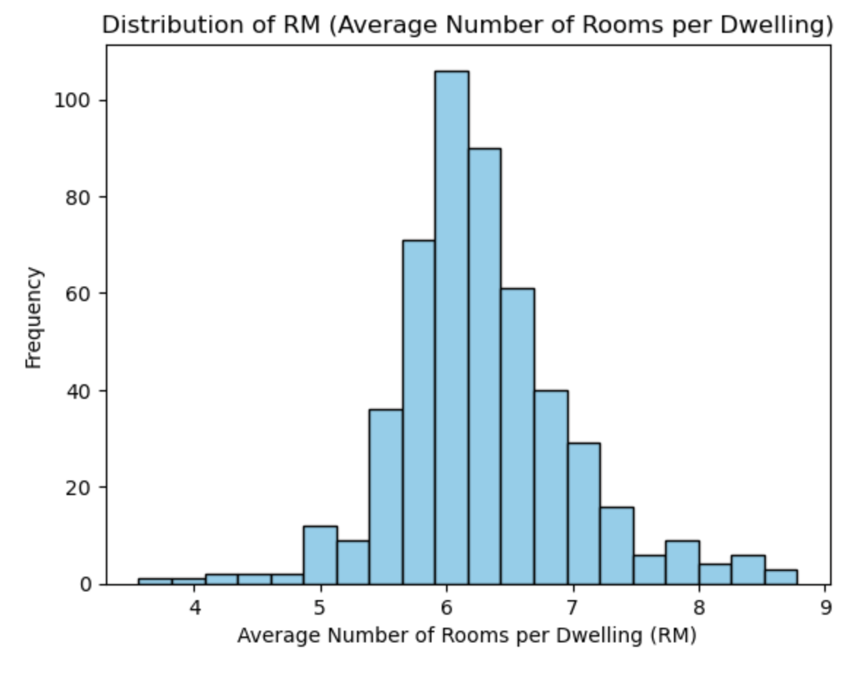
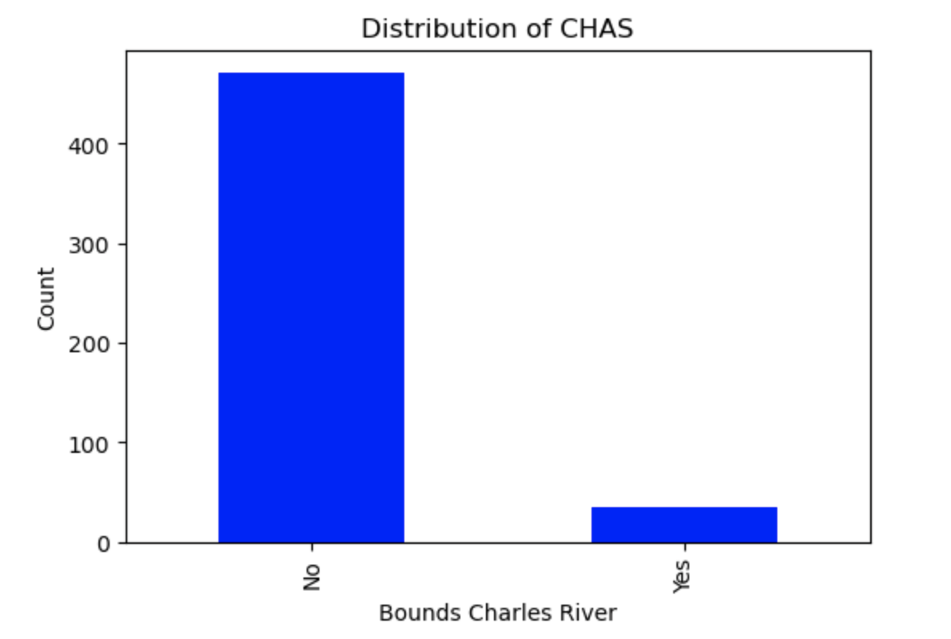

Slide 9
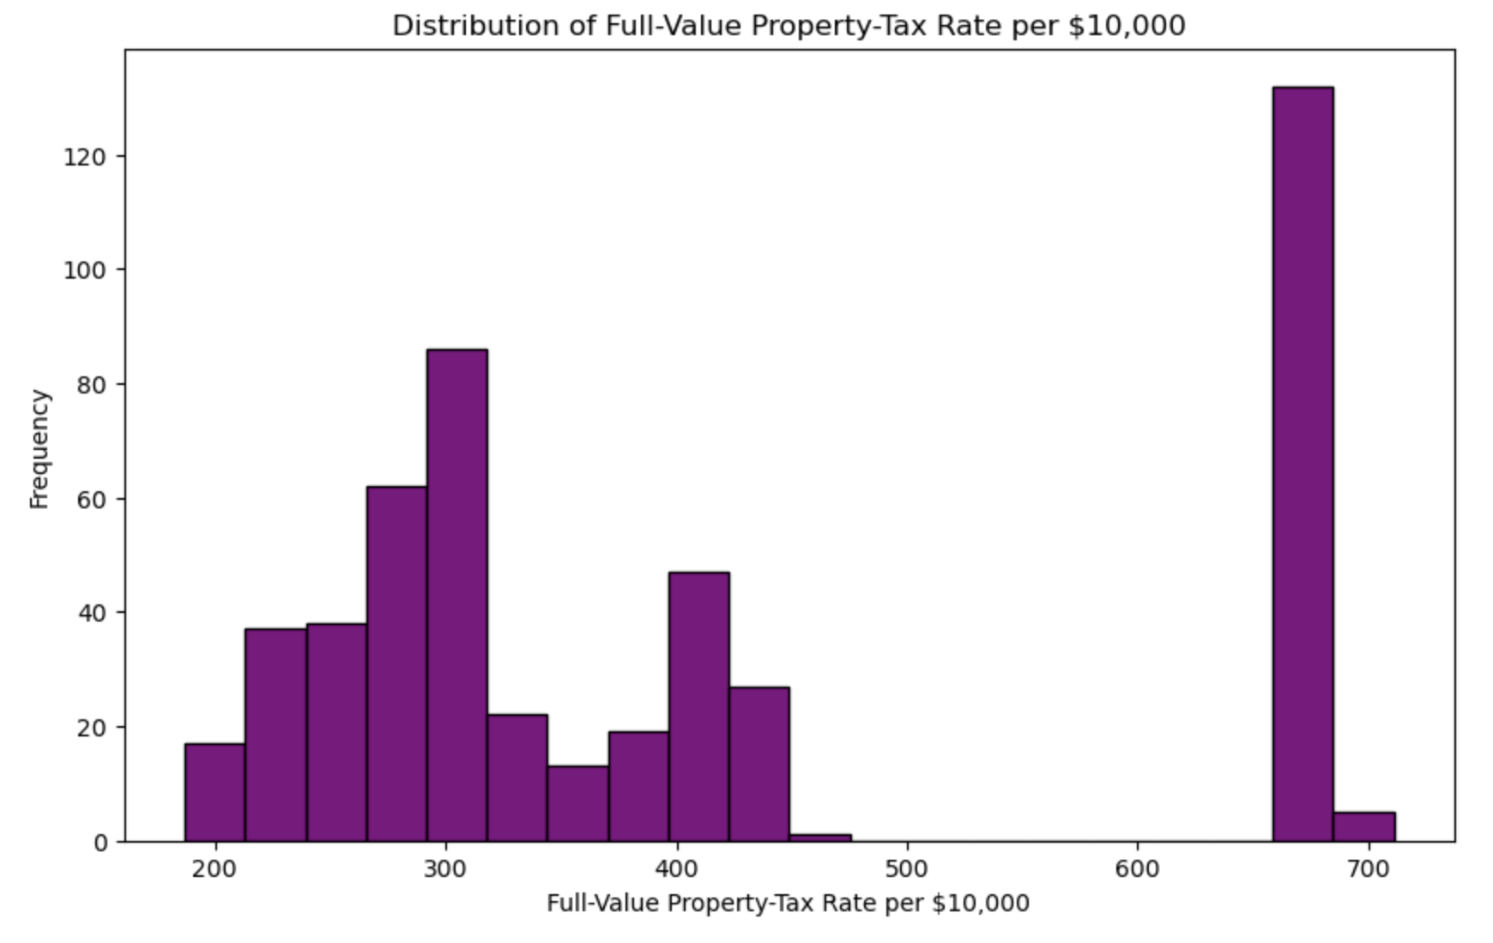
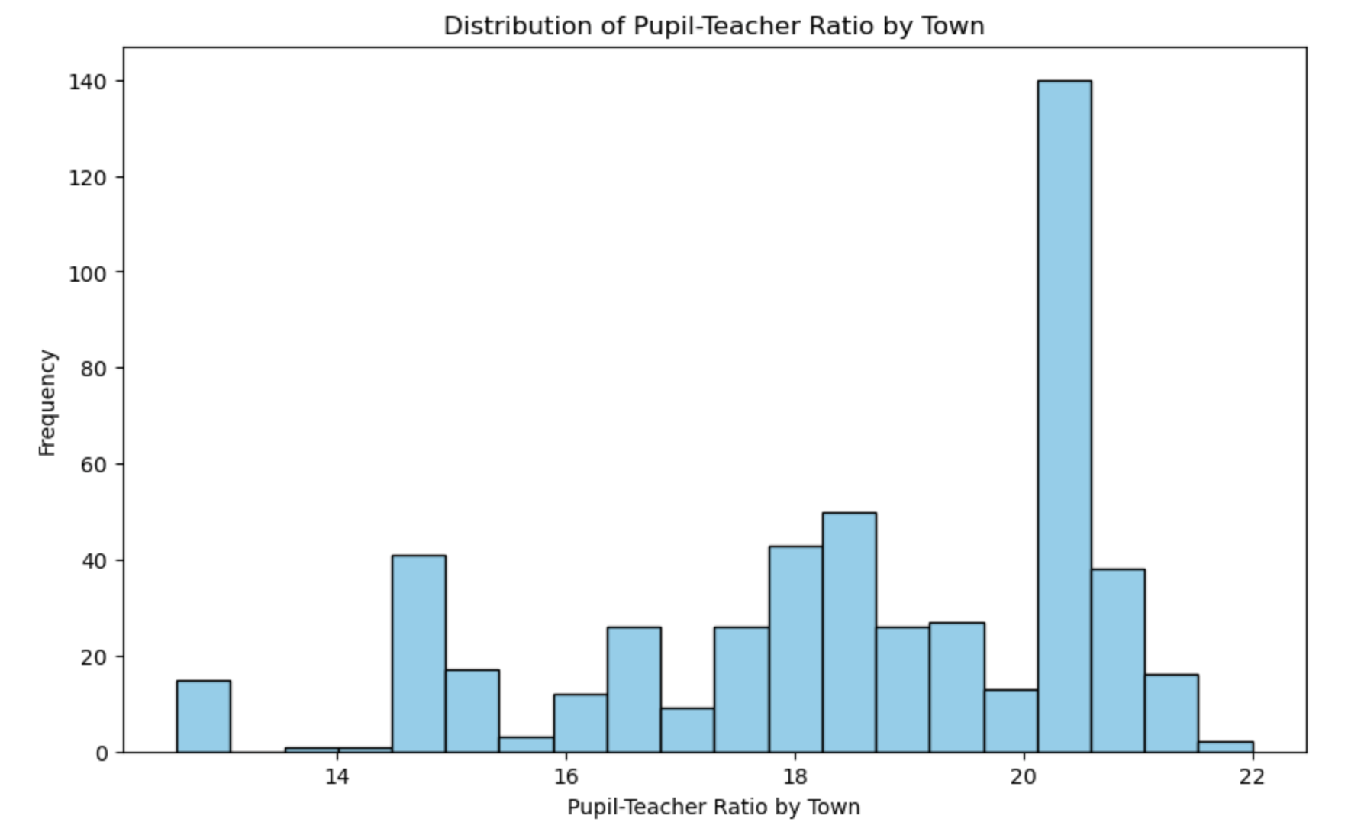

Slide 10
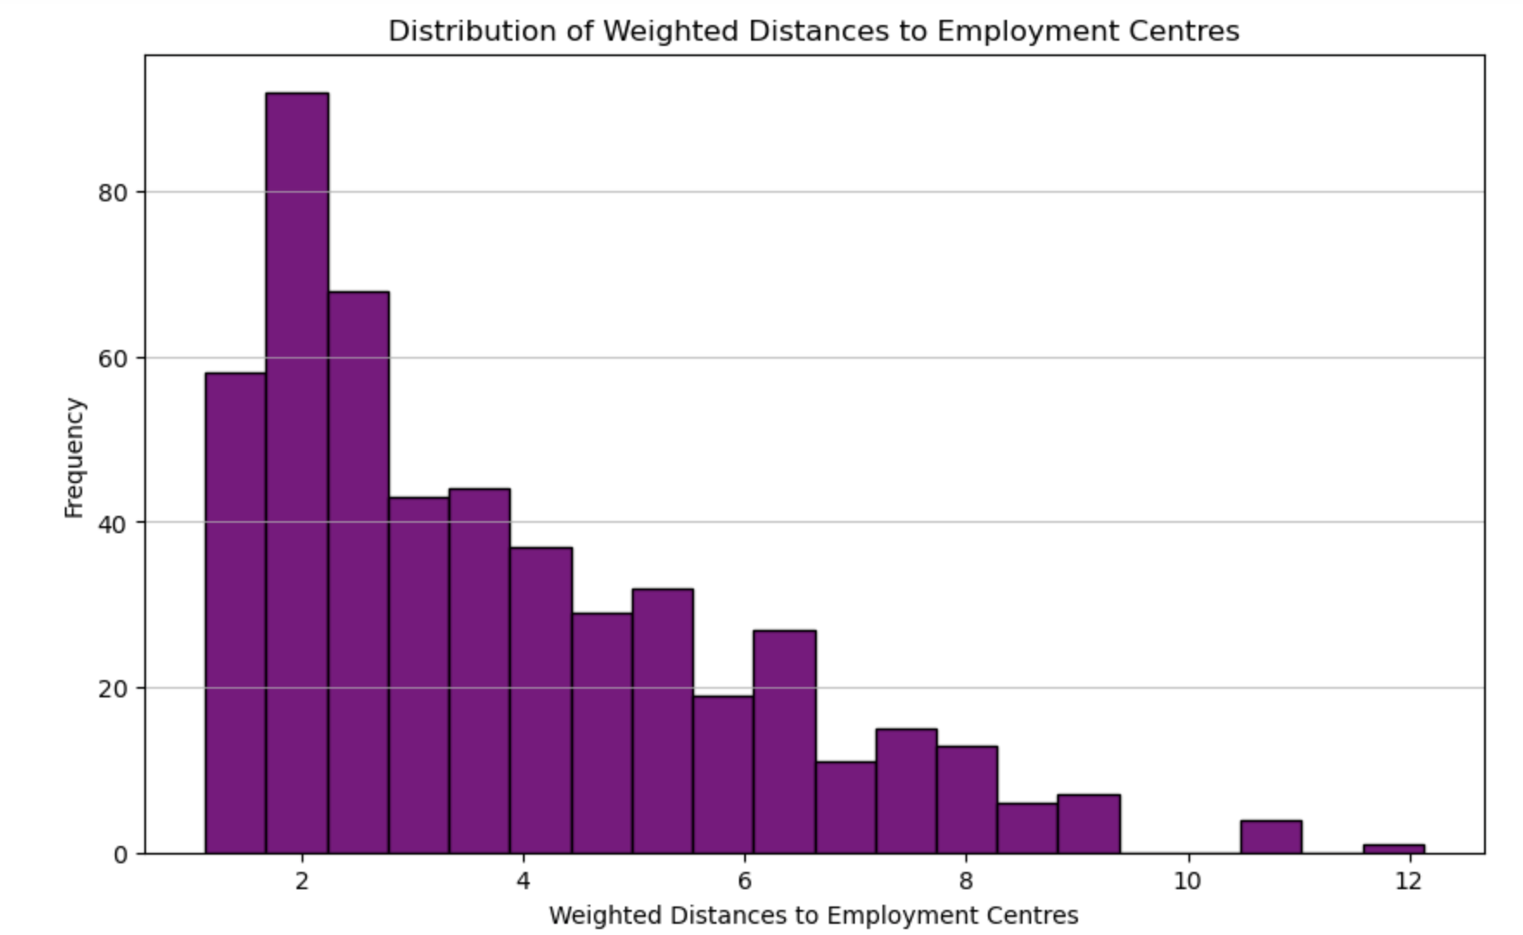
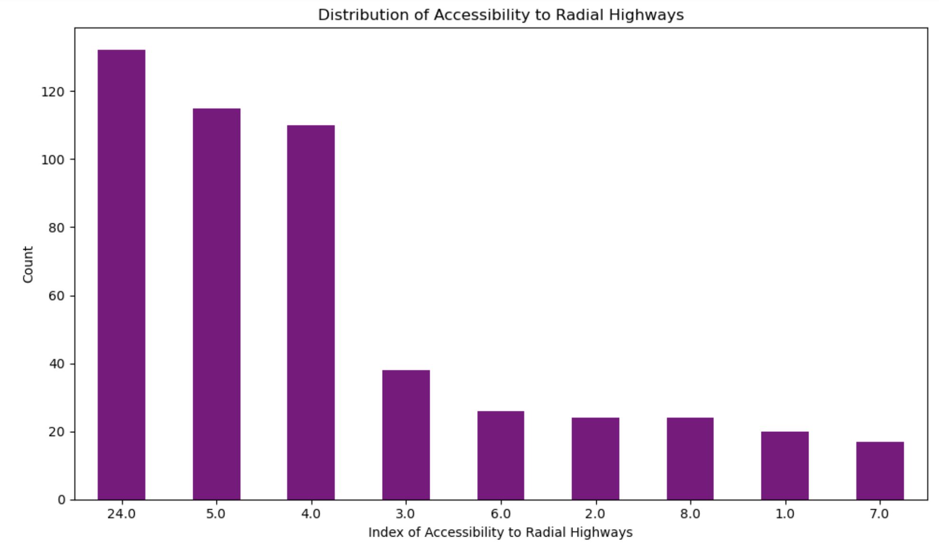

Slide 11
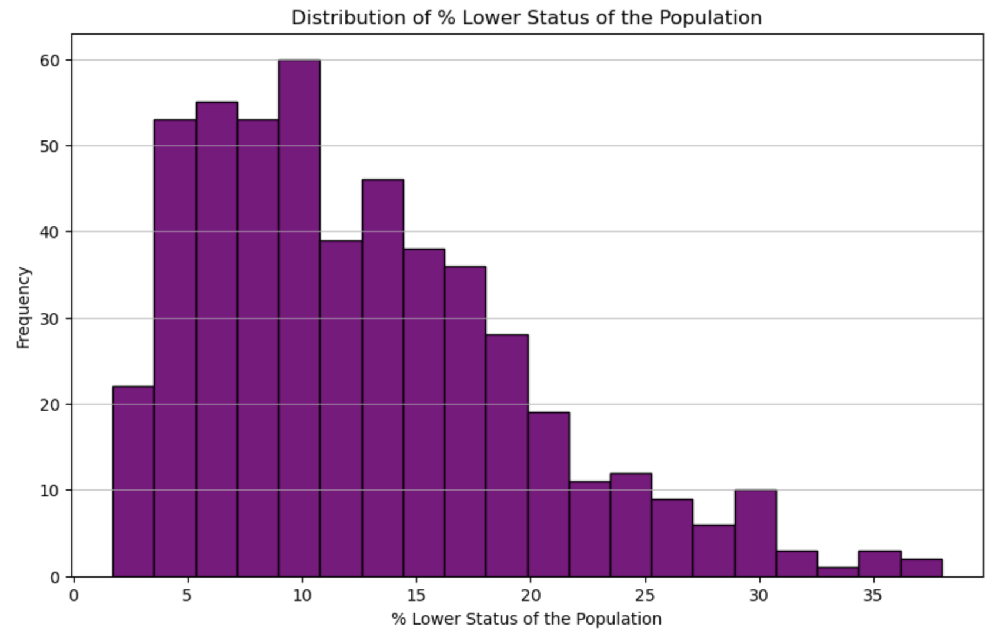
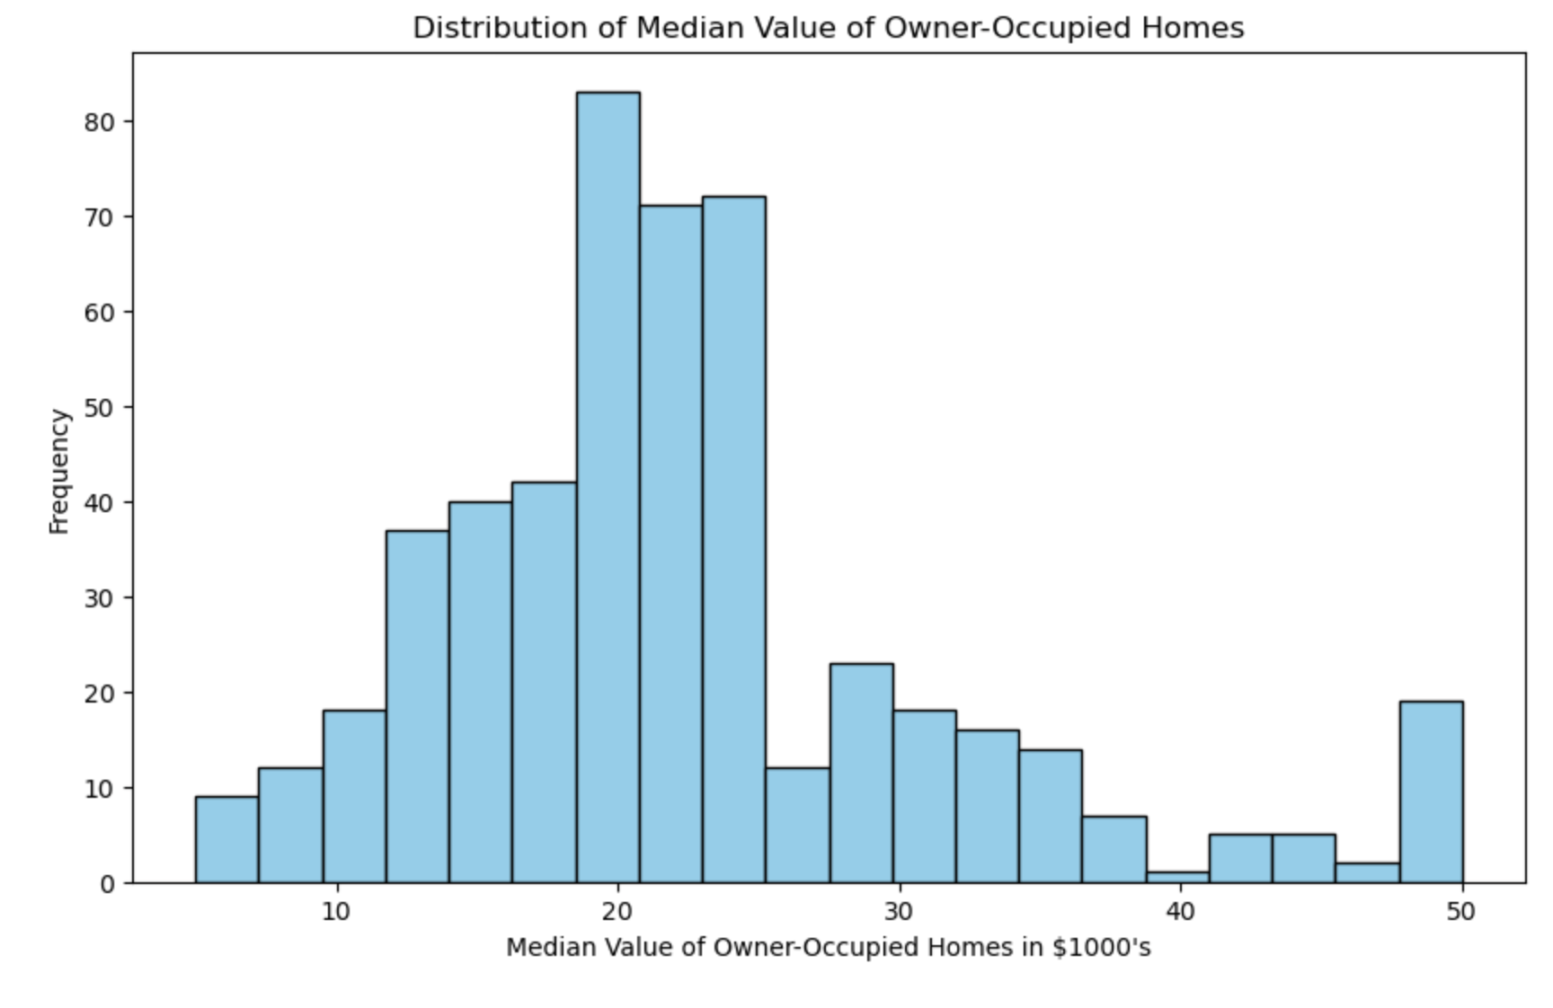

Slide 12
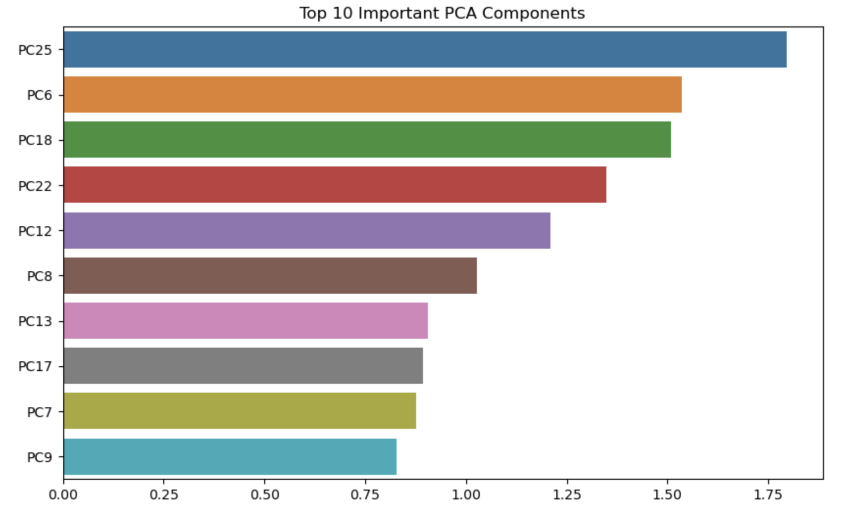
Machine Learning Model: Linear Regression
Purpose: Predicting MEDV, the median value of owner-occupied homes
Model Used: Linear Regression (most common for this dataset)
Key Insights:
Features like RM (average number of rooms per dwelling) and LSTAT (% lower status of the population) are strong predictors of MEDV.
The model may also include interaction terms or polynomial features for non-linear relationships

Slide 13
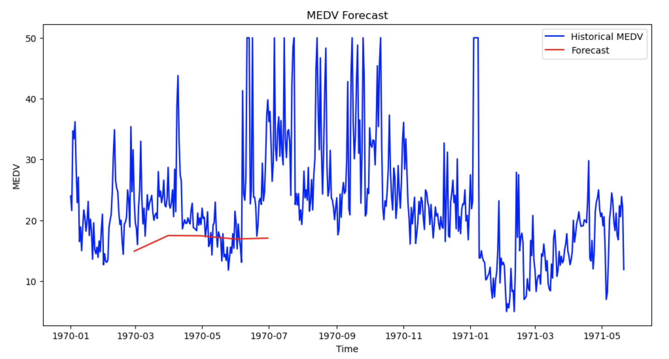

Slide 14
Linear Regression Pros & Cons
Pros
Simplicity and Interpretability
Computationally Efficient
Established Methodology
Feature Importance
Predictive
Cons
Assumption of Linearity
Sensitive to Outliers
Prone to Overfitting with Many Features
Assumption of Independence
Homoscedasticity

Slide 15
Summary and Next Steps
Model Validation
Alternative Models
Regularization
Diagnostics
Advanced Techniques
ARIMAS: Autoregressive Integrated
Moving Average Model
Time Series Model Type
ARIMA model will be used in the next simulation
Analyze and predict future values in a time series based on its past behavior and inherent statistical properties

